Slide 1


Introduction to Molecular Biology
Lab 1
Dr. Rawa Abdul Redha Aziz
Ph.D Antibiotics/ Molecular biology

Slide 2
Syllabus Content
Subject | Lab. No.
The preparation of buffers | 1
Laboratory safety rules | 2
DNA extraction | 3
Instruments and equipment in molecular biology lab | 4
Polymerase chain reaction | 5
Gel Electrophoresis | 6
Chromosomal DNA extraction from bacteria | 7
Mid Exam | 8
Chromosomal DNA extraction from plant | 9
Plasmids isolation and extraction | 10
Protein | 11
Real time PCR | 12
Seminar 1 | 13
Seminar 2 | 14
Final Exam | 15

Slide 3
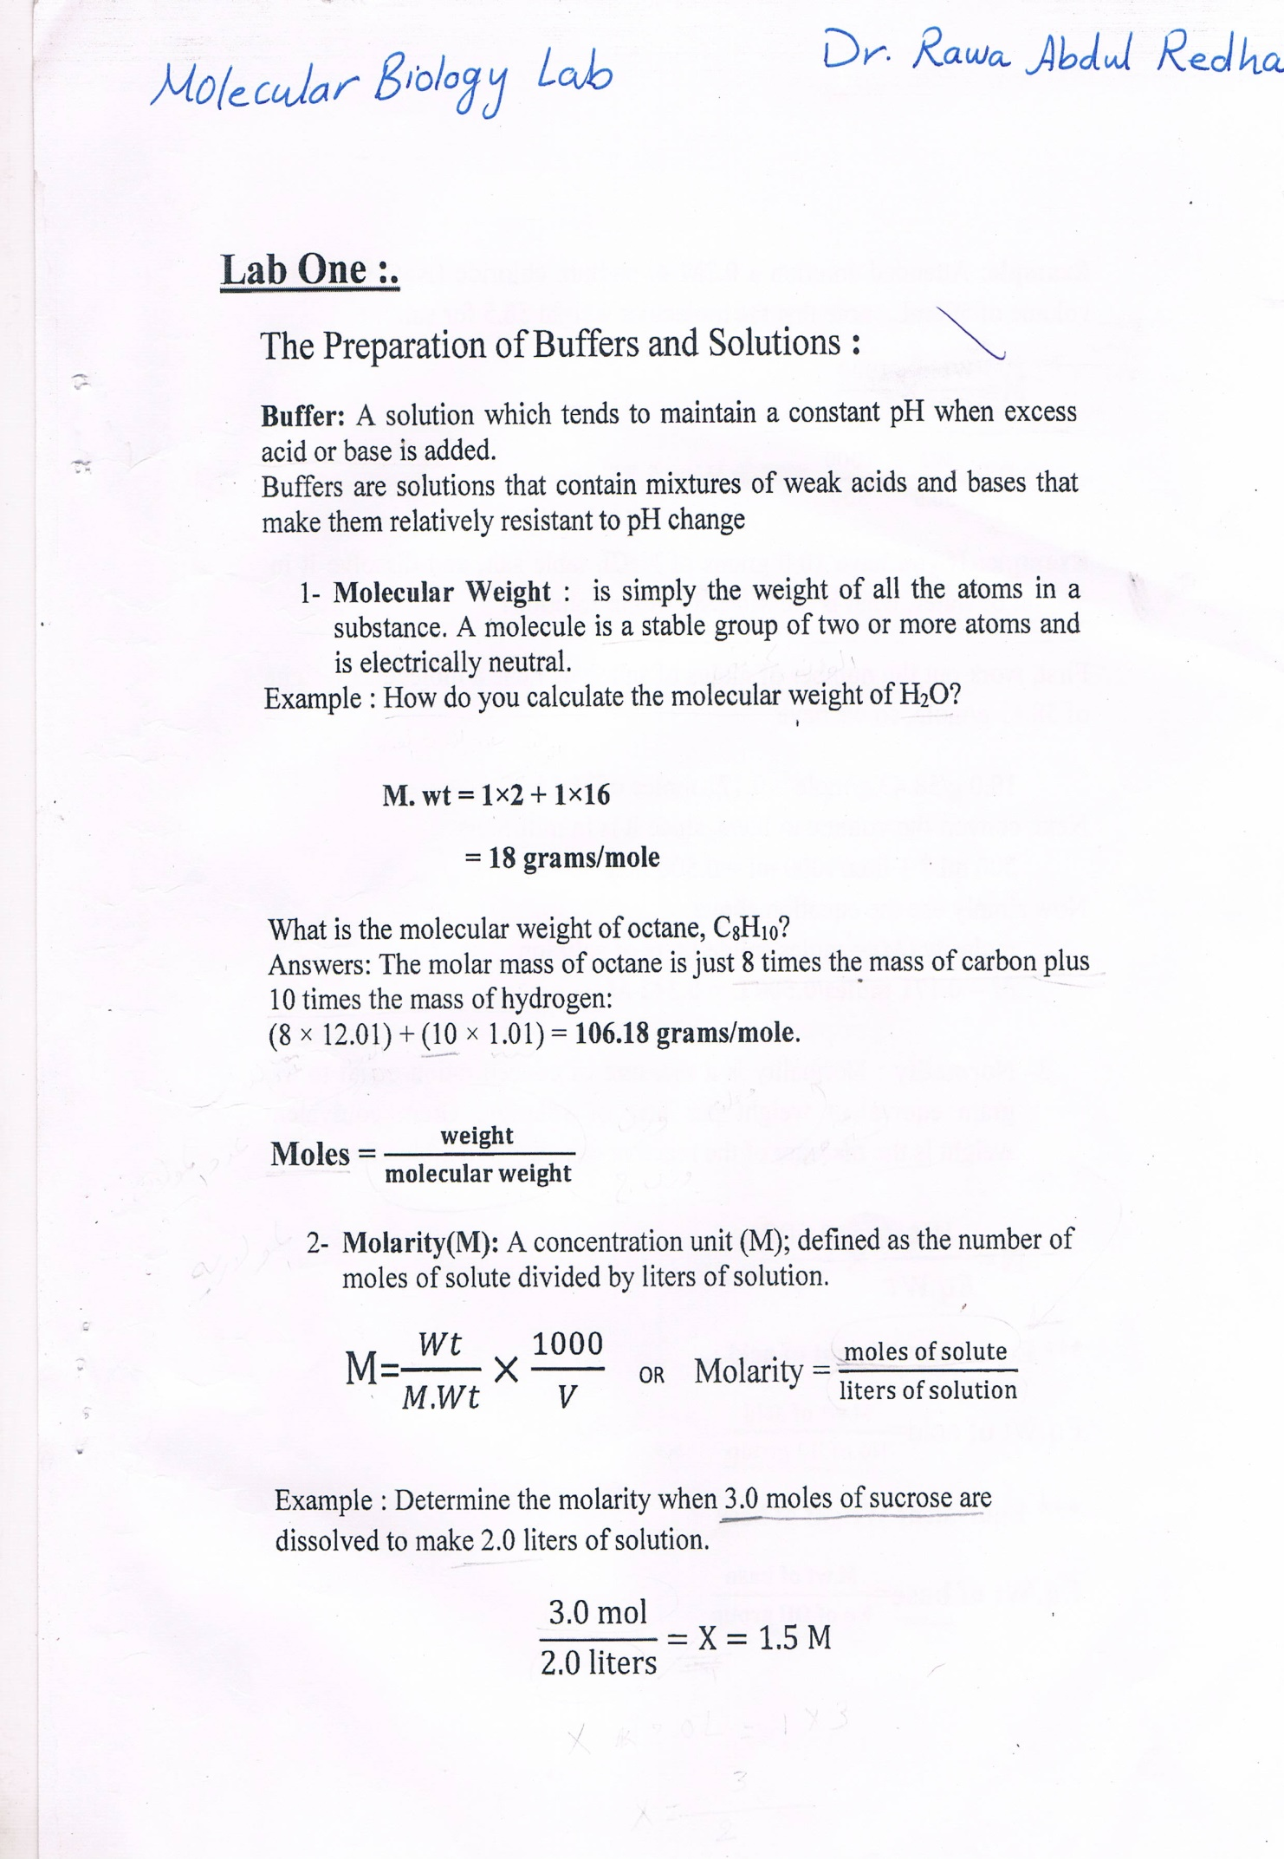

Slide 5
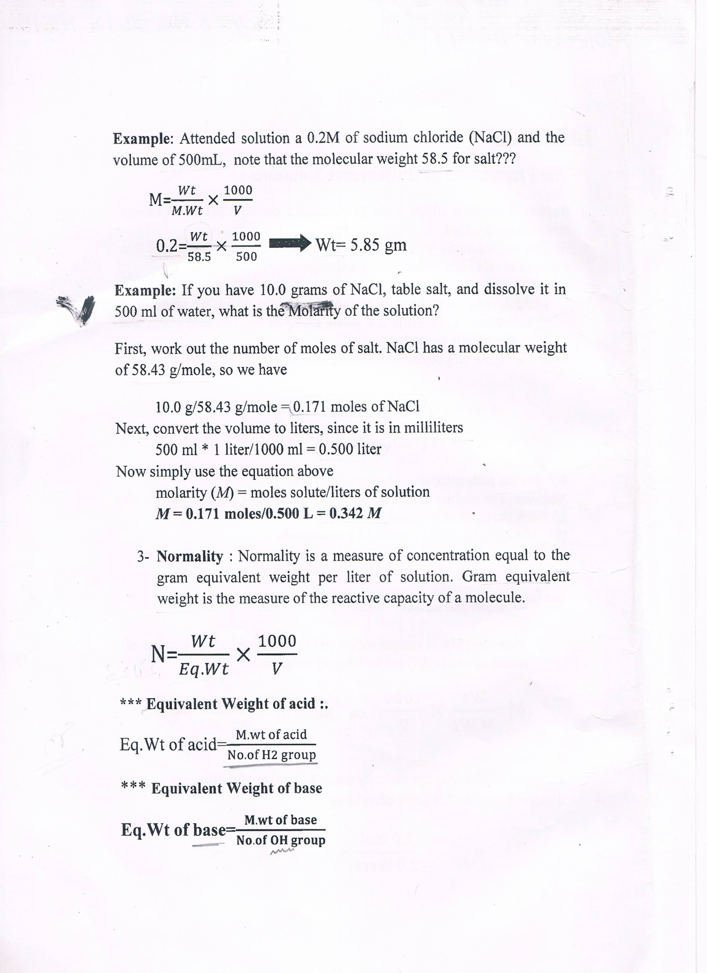

Slide 7
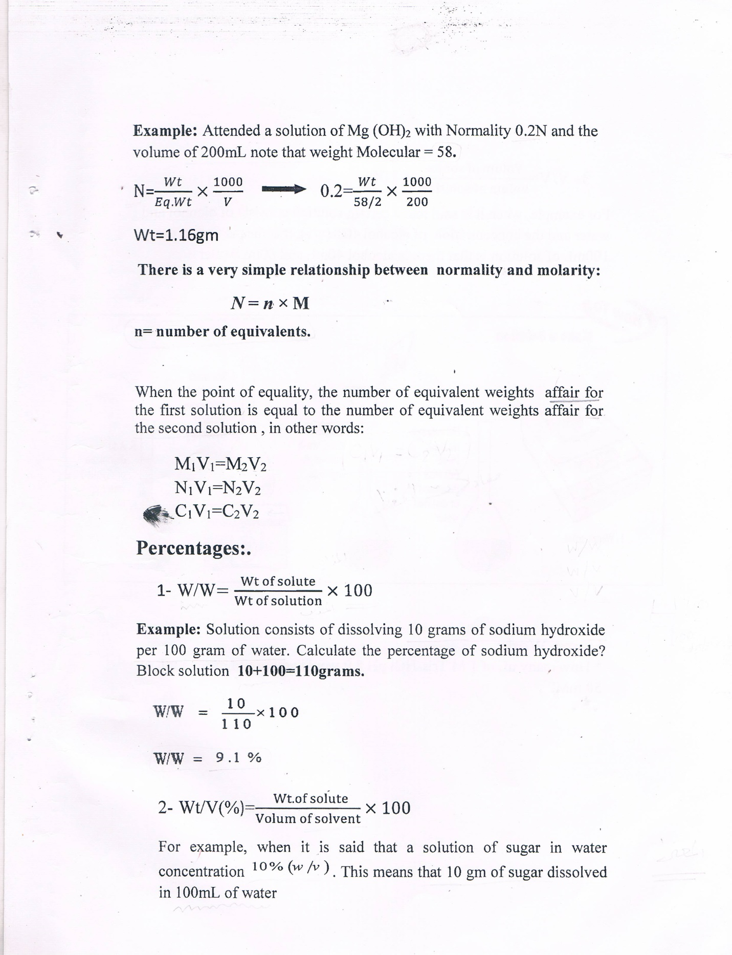

Slide 9
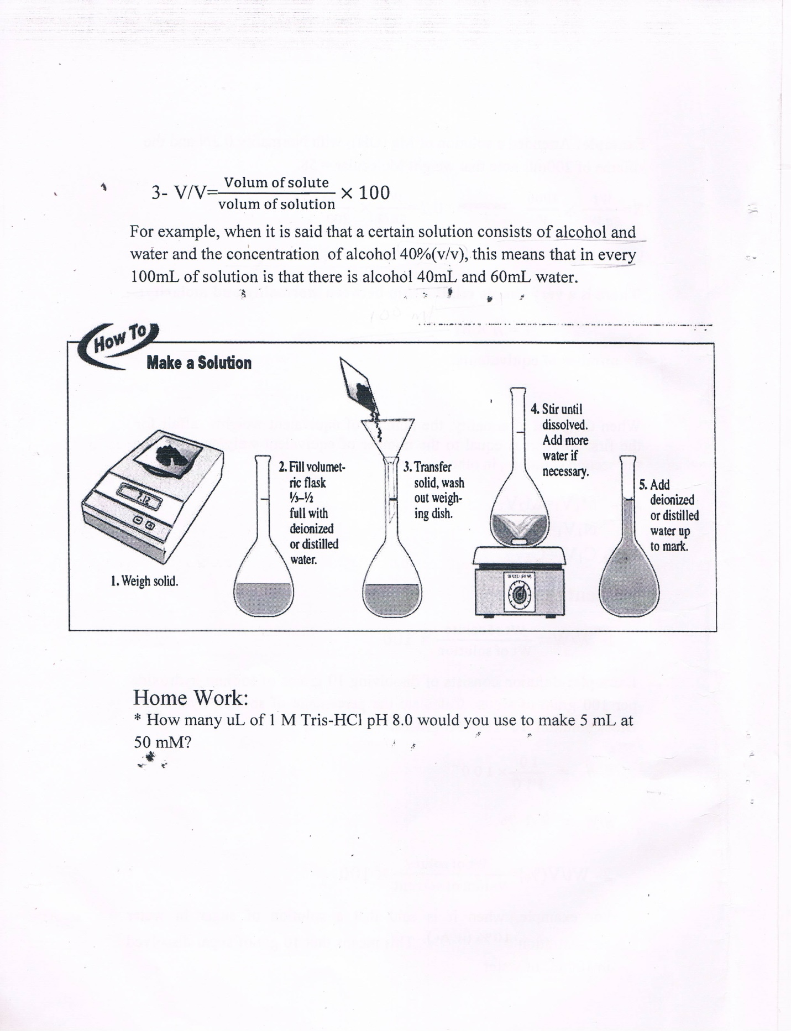

Slide 10

Any Question?

